Slide 1

gamerspace.compuconsultations.com

Slide 2



HOME AND ABOUT US

Slide 3

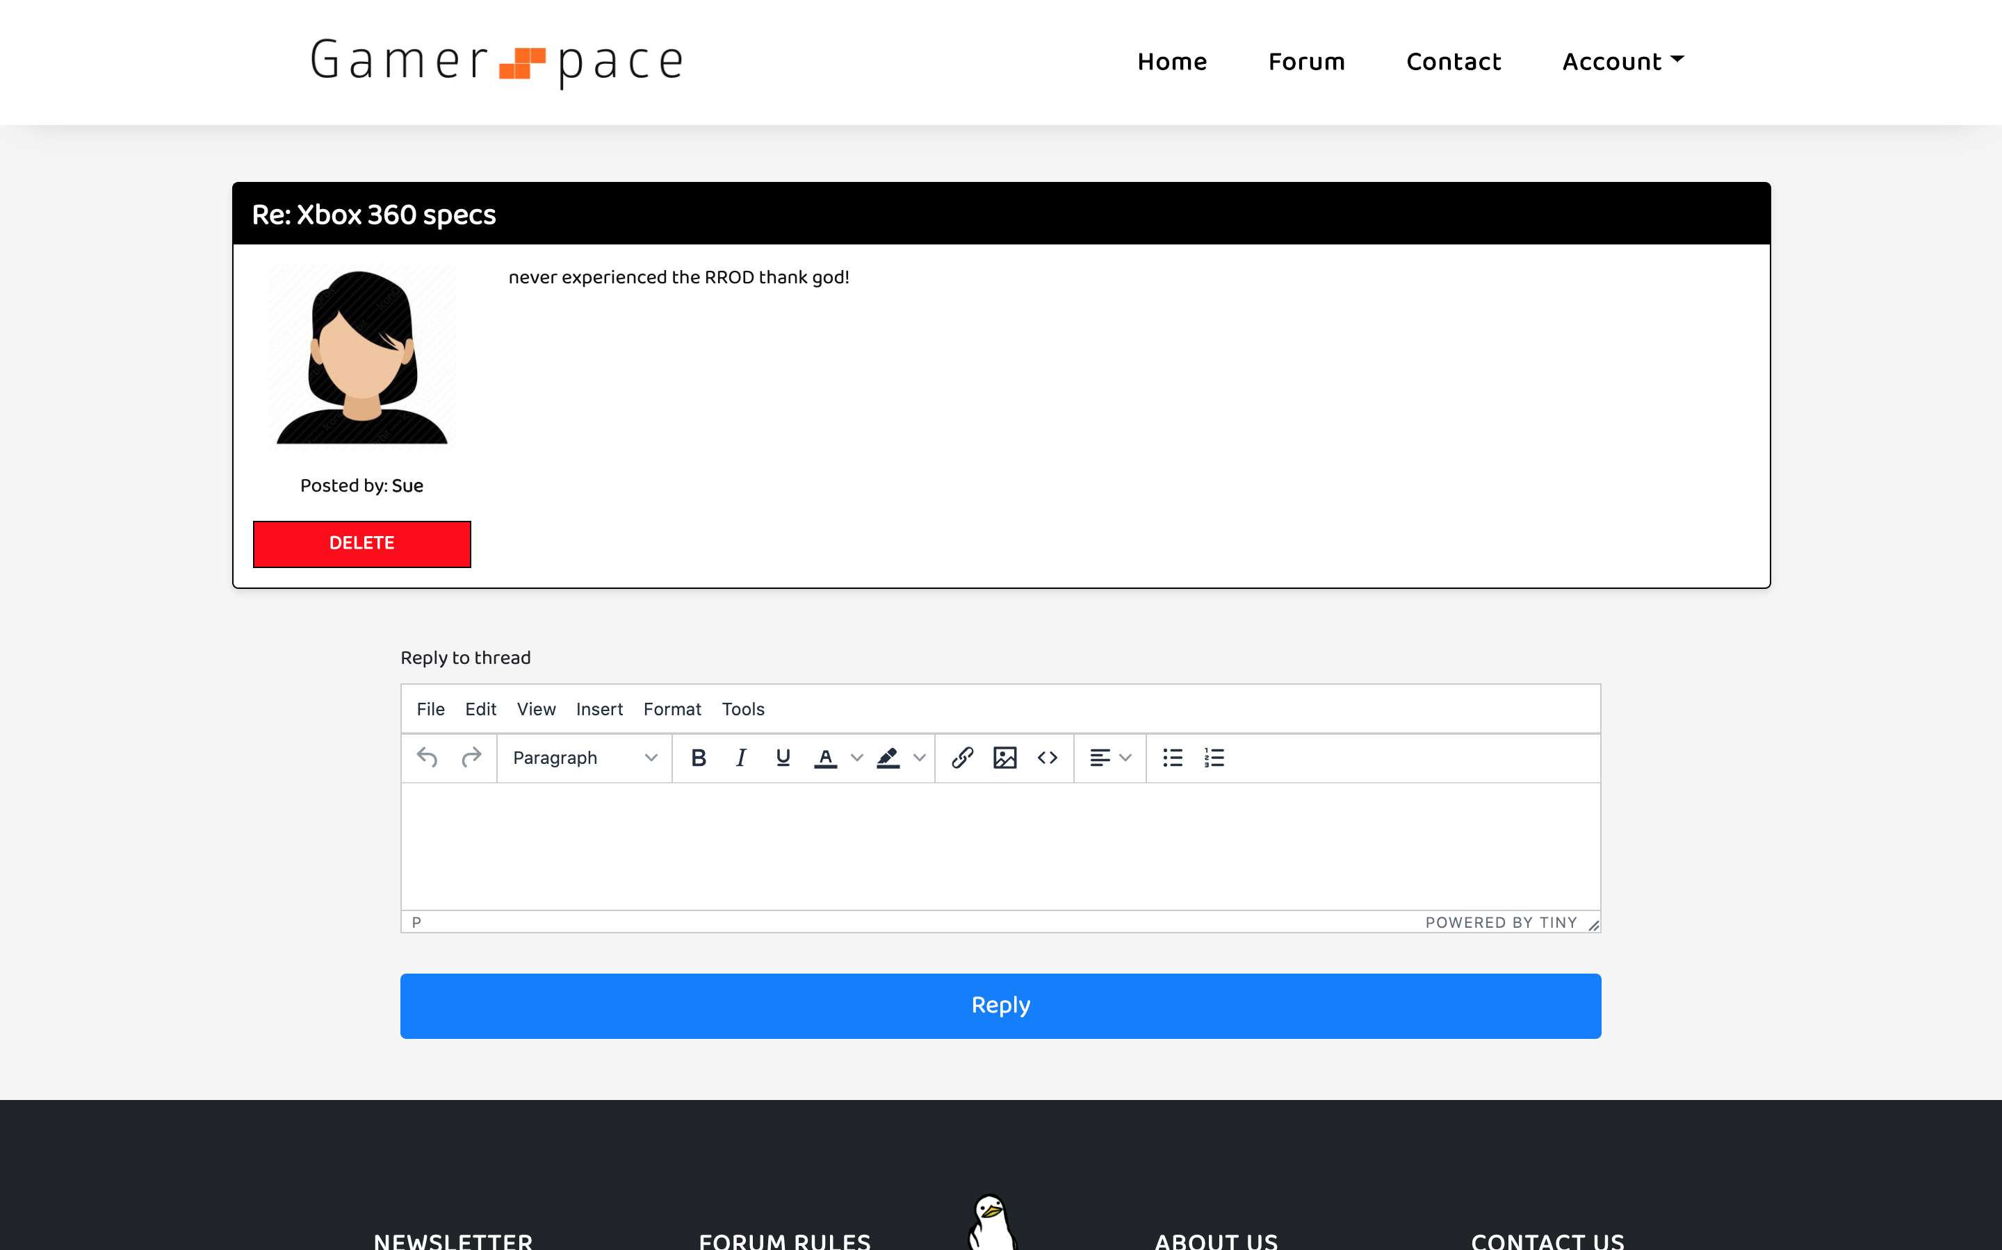
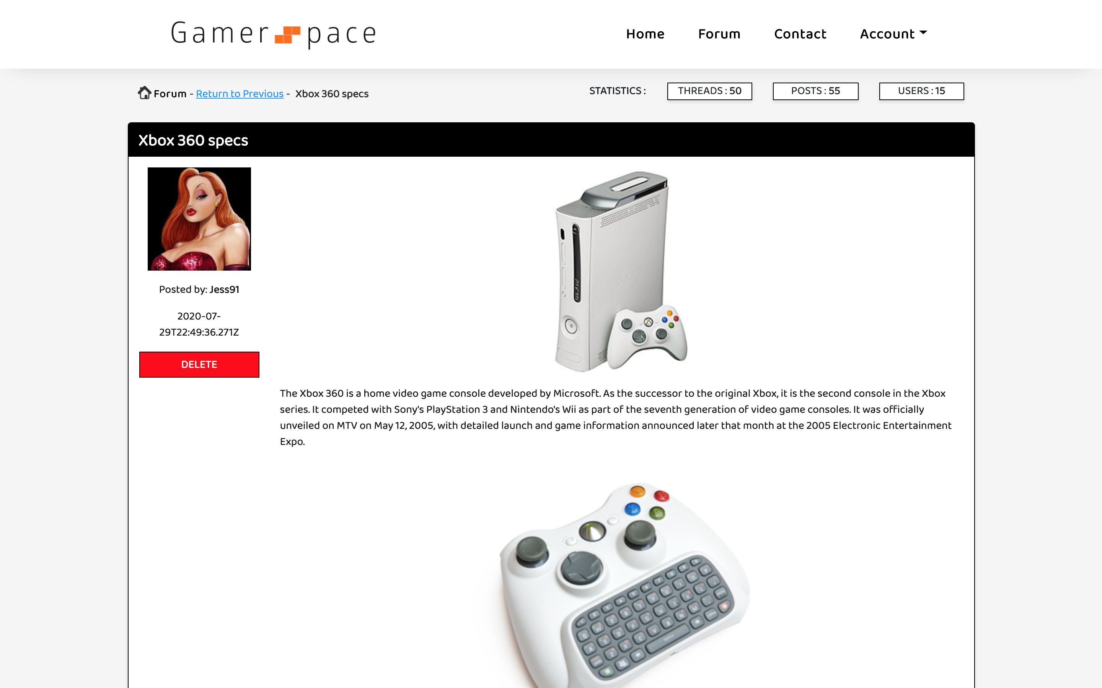
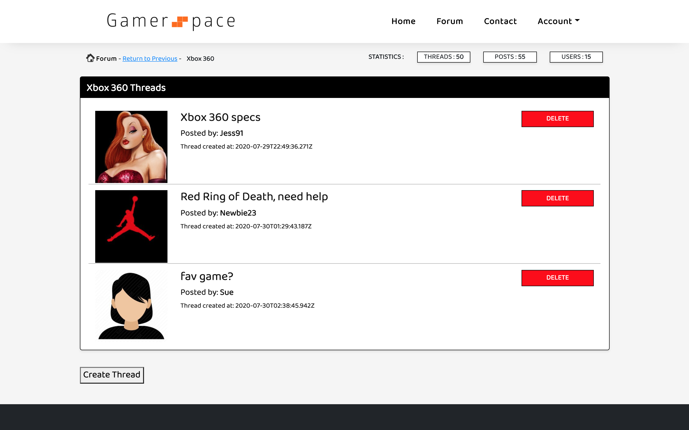
THREADS

Slide 4

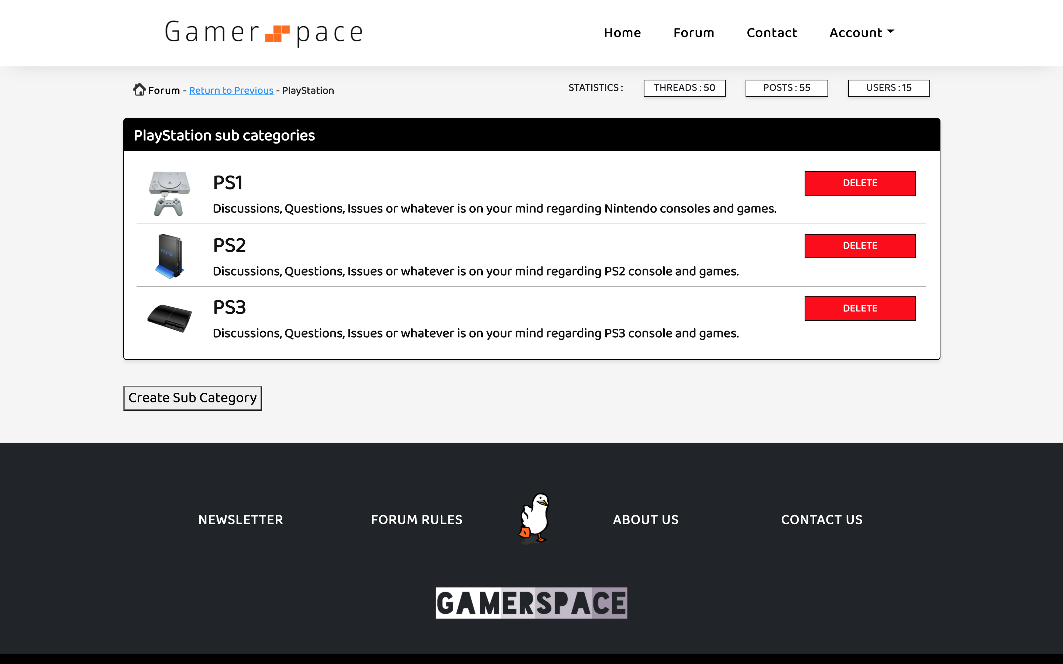
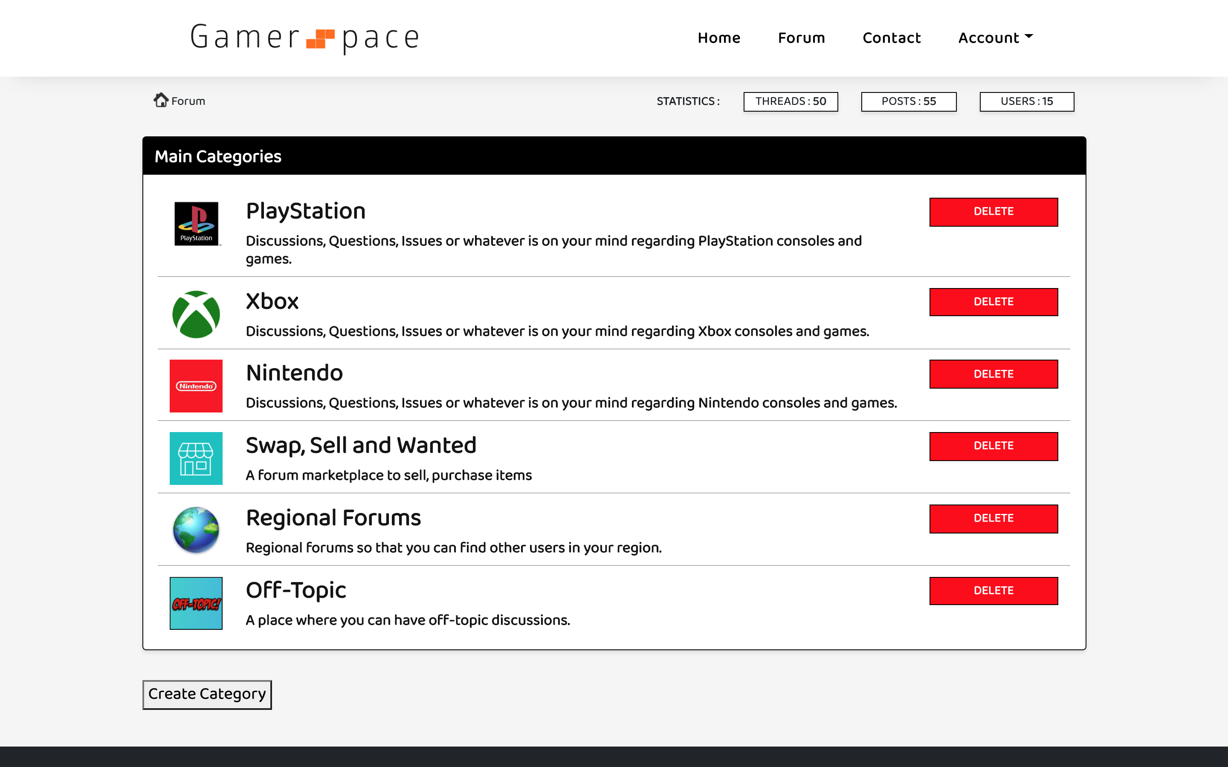

FORUM CATEGORY VIEWS

Slide 5

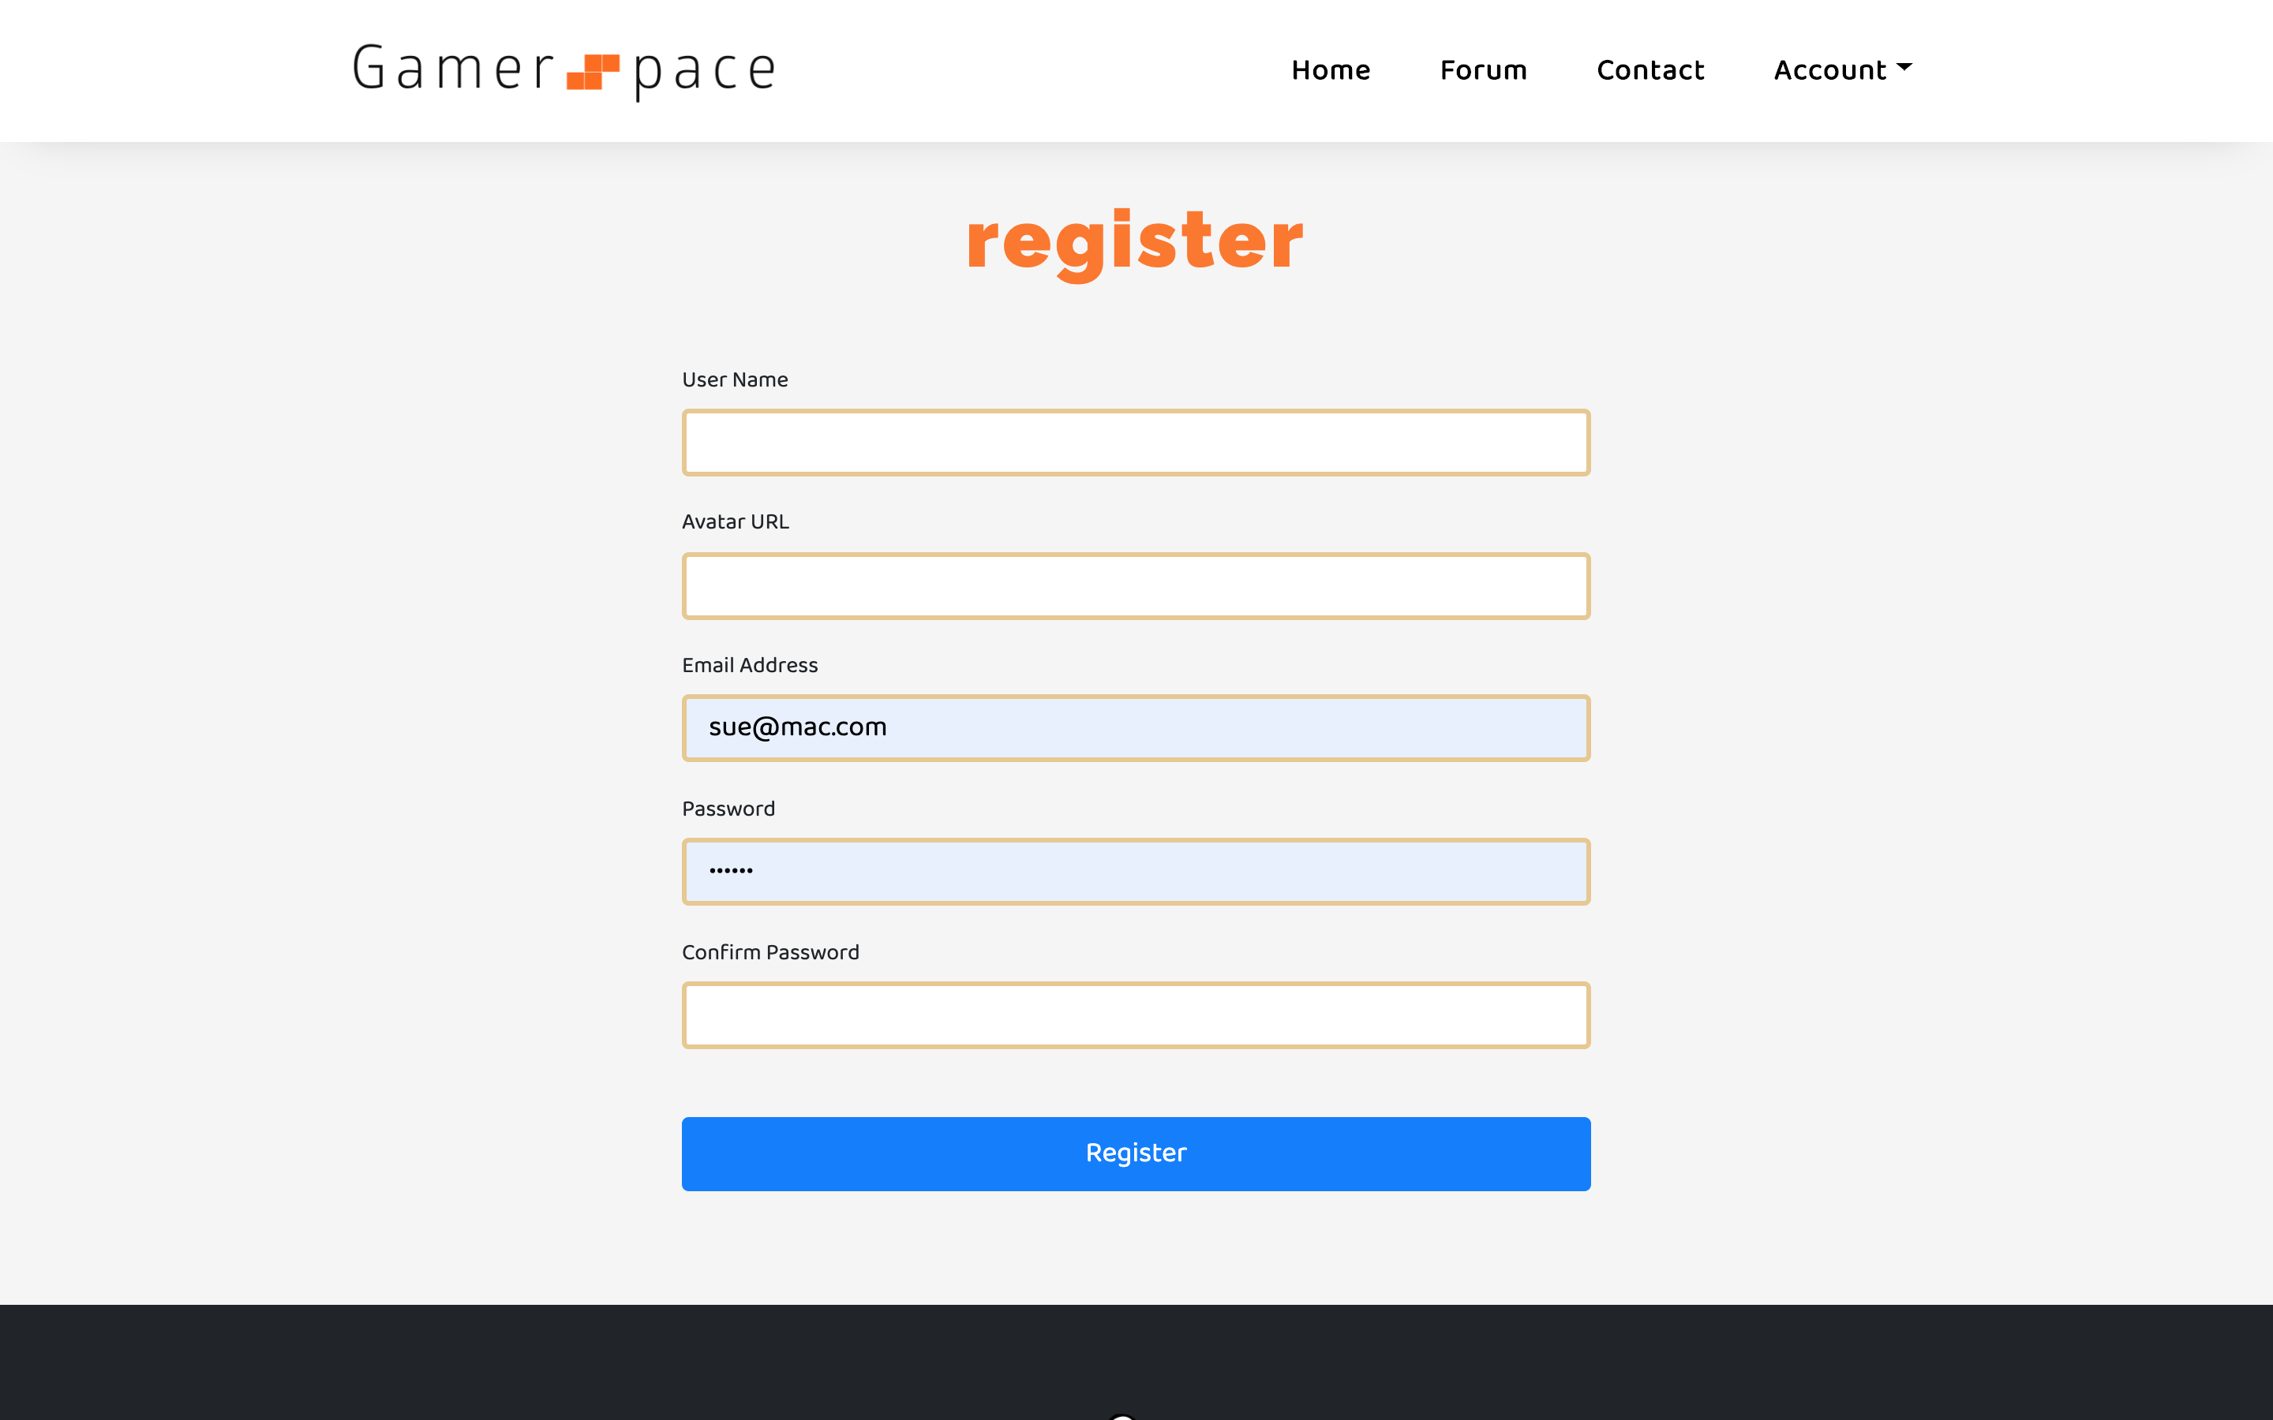

JOINING

Slide 6


ADDITIONAL DATA COLLECTION

Slide 7



OTHERVIEWS

